Slide 1


IBM PROJECT PRESENTATION
On
"Online Blockchain based certificate generation and validation system for government organization"
By
Group ID: G29
Patel Nirva Nileshkumar (20162101014)
Abel Benedict (20162171001)
Archan M Vyas (21162122007)
Under the guidance of Palwinder S , Prof. Ravindra Patel
Institute of Computer Technology, Ganpat University
Date: 10 th May

Slide 2
TABLE OF CONTENT
Introduction
Objectives
Related Background
Expected Outcome
Tools & Technology
Methodology (Modules)
Design / Diagrams & TimeLine Charts with Milestones
Flowchart & Algorithms
Implementation Details
Conclusion
References

Slide 3
INTRODUCTION
Traditional methods of certificate generation and validation in government organizations are often time-consuming, manual, and prone to errors.
The increasing need for secure and tamper-proof certificates has led to the exploration of innovative technologies like blockchain.
Blockchain technology, known for its decentralized and transparent nature, presents an ideal solution to enhance the efficiency and trustworthiness of certificate-related processes.

Slide 4
SCOPE
The scope of this project is to develop a blockchain based system for issuing, storing and verifying all government issued certificates. It will provide the following capabilities:
Issuing digital certificates with cryptographic signatures
Immutable record of certificates on a blockchain
Online verification of certificate authenticity

Slide 5
GOALS AND OBJECTIVES
Objective 1
Objective 2
Implement a permissioned blockchain network for storing certificate data
Develop web portal for government agencies to issue digital certificates
Objective 3
Objective 4
Create a verification API for third parties to authenticate certificates
Ensure integrity, security and privacy of certificate data

Slide 6
RELATED BACKGROUND
Blockchain technology provides decentralized, transparent and secure record keeping through cryptographic hashes, distributed ledgers and consensus mechanisms. A permissioned blockchain restricts access and roles for different participants. Digital signatures provide authentication and non-repudiation.

Slide 7
EXPECTED OUTCOME
1. Enhanced Security with Blockchain: Tamper-Proof Records
2. Potential Cost Saving
3. Enhanced Accessibility and Transparency
4. Reduced Fraud & Misuse of Certificates

Slide 8

TOOLS & TECHNOLOGIES
1. Local Blockchain Nodes
2. Ethereum Network
3. SHA256 Hash
4. NodeJS, ReactJS
5. MongoDB
6. Cloud Hosting (AWS)
7. Anaconda Navigator
8. Python

Slide 9
METHODOLOGY (MODULES)
1. Certificate Generation Module
2. Certificate Validation Module
3. Blockchain Integration Module
4. User Authentication Module
5. Database Management Module

Slide 10
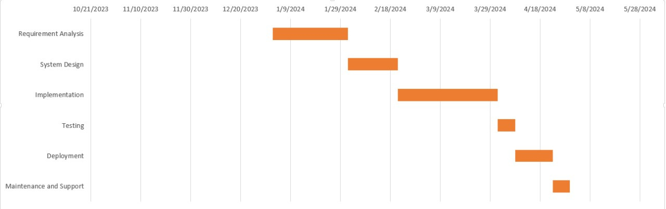
TIMELINE CHARTS

Slide 11

SIGNUP PAGE

Slide 12
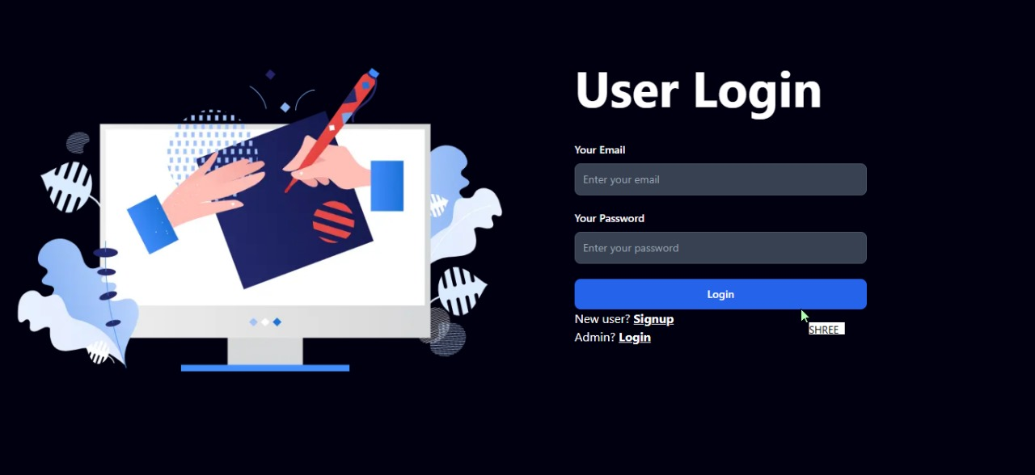
LOGIN PAGE

Slide 13
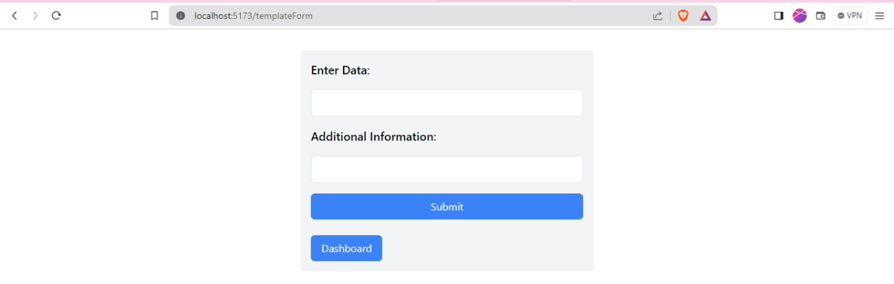
CERTIFICATE TEMPLATE FORM

Slide 14
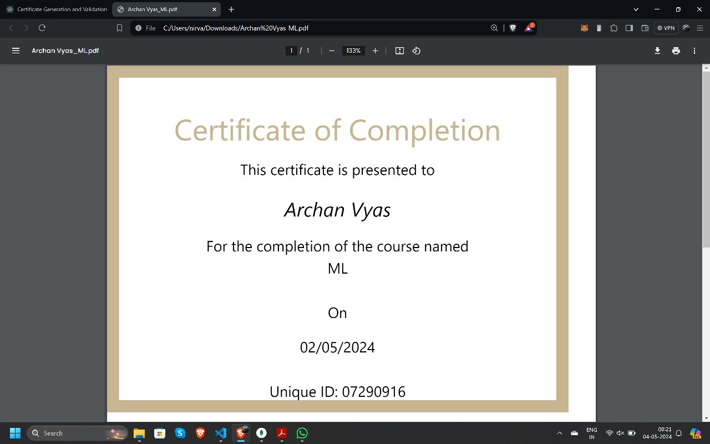
GENERATED CERTIFICATE

Slide 15
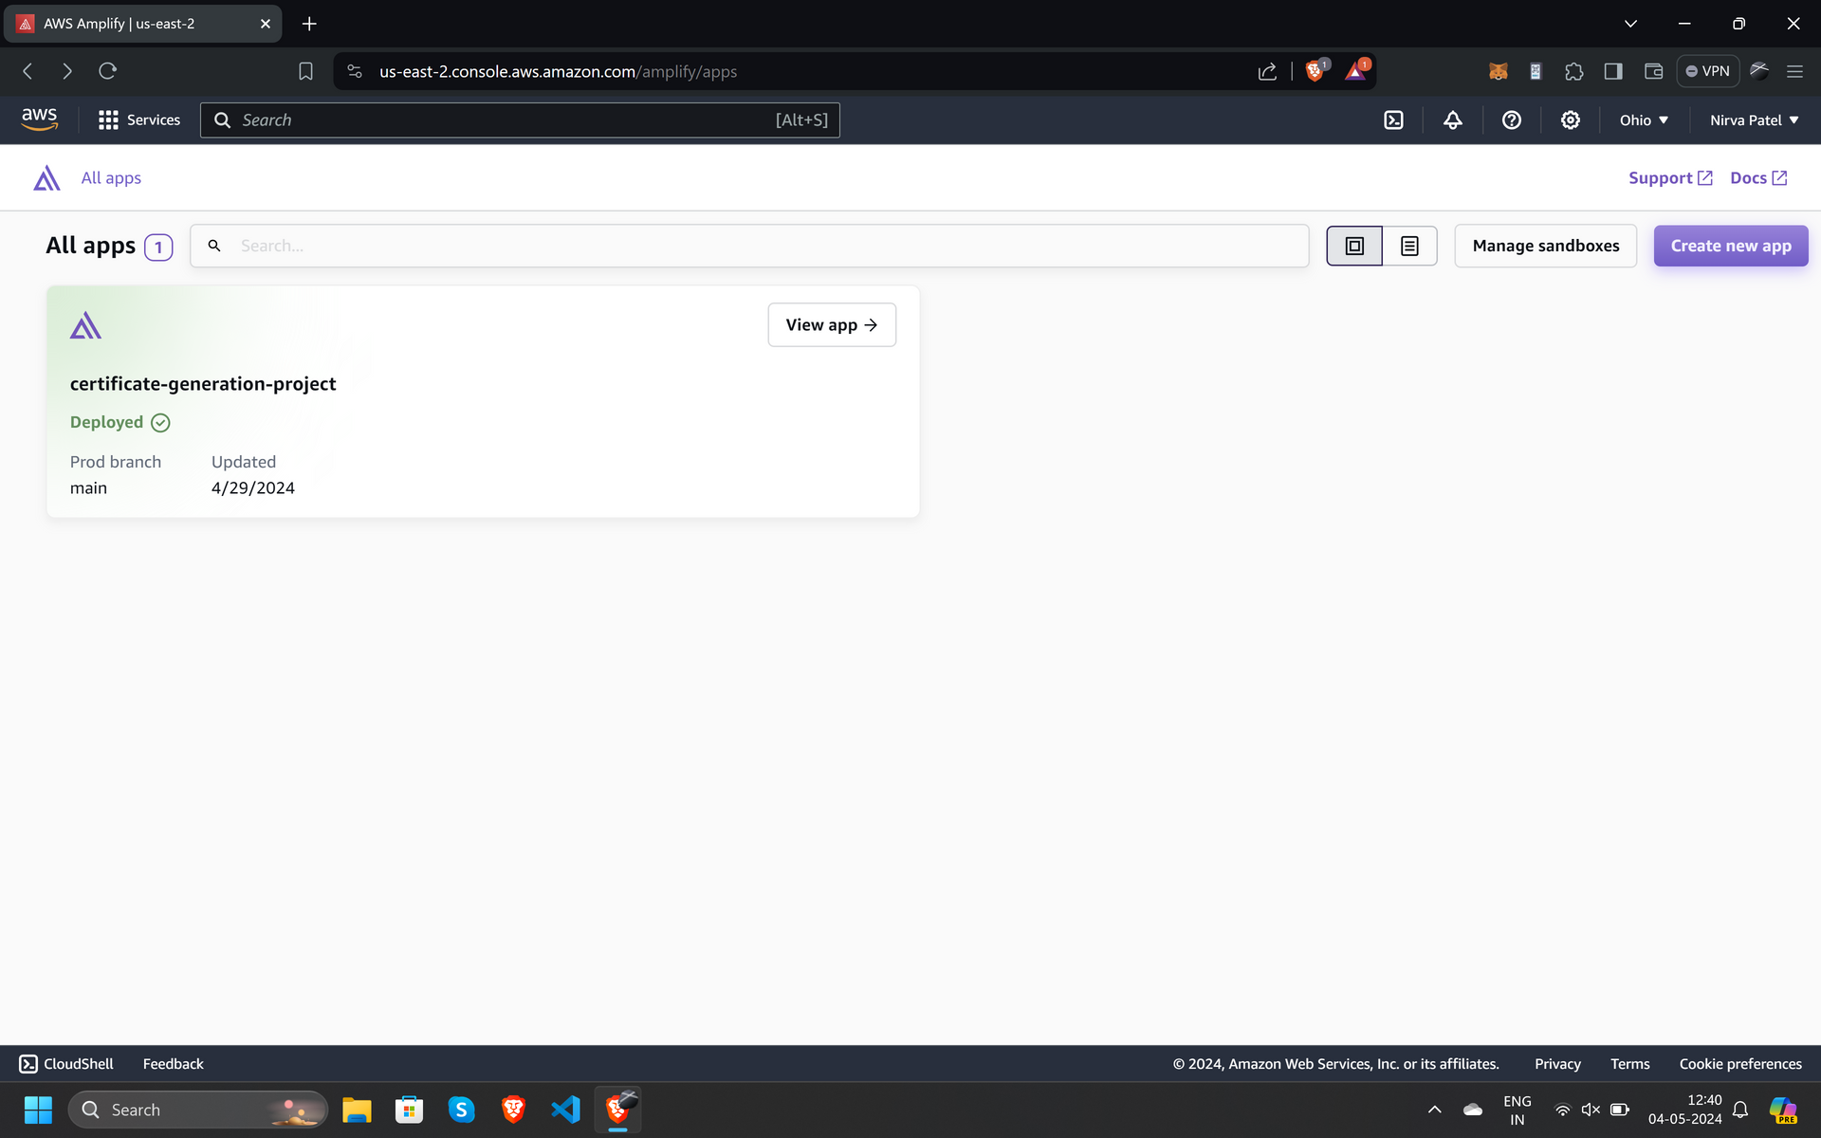
FRONTEND DEPLOYMENT
WEBSITE URL

Slide 16
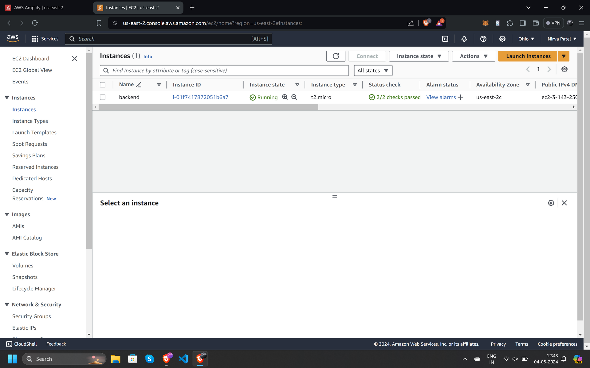
BACKEND DEPLOYMENT

Slide 17
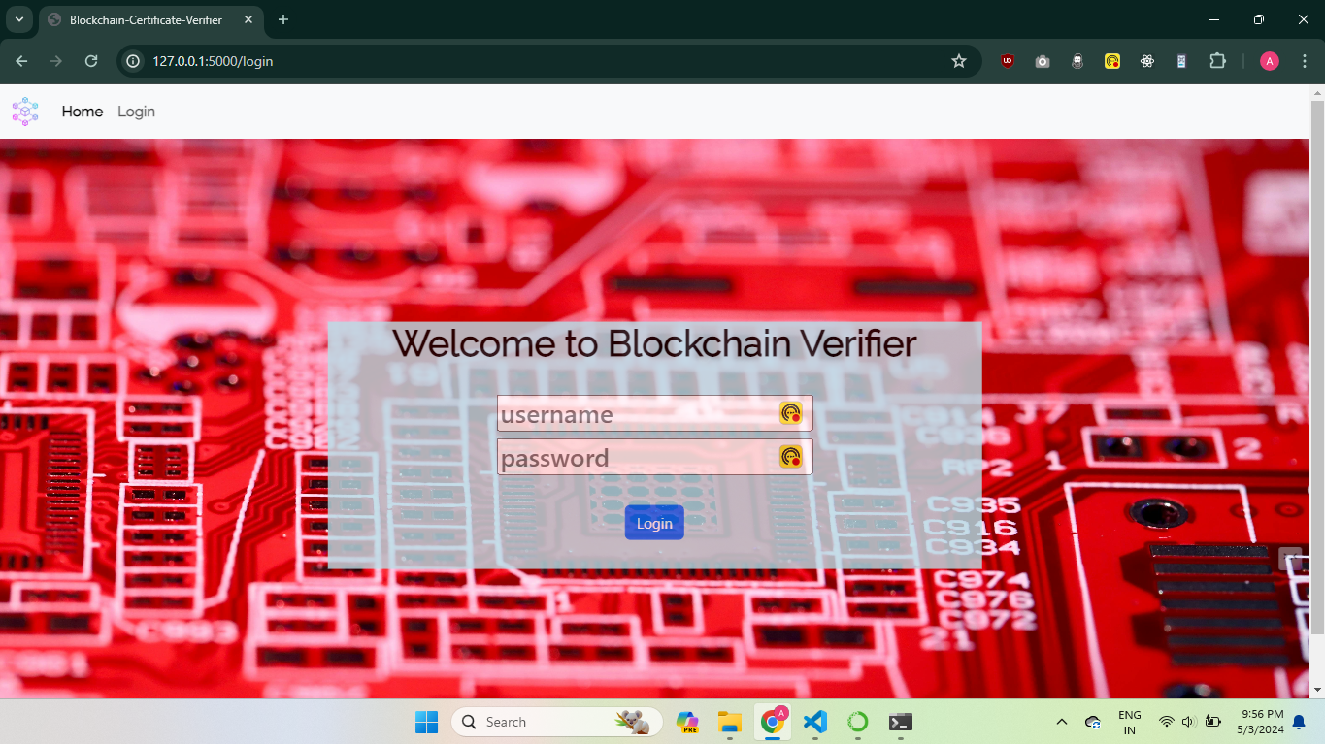
ADMIN PANEL FOR VALIDATION

Slide 18
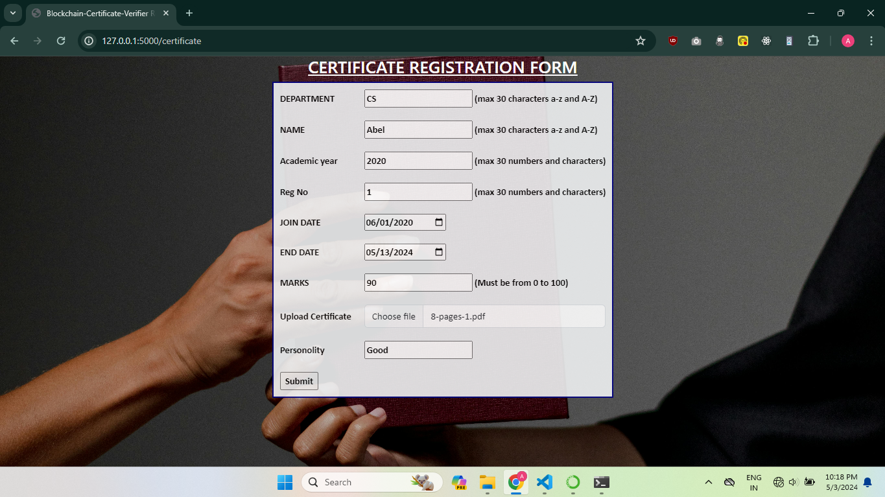
ADDING CERTIFICATE DETAILS

Slide 19
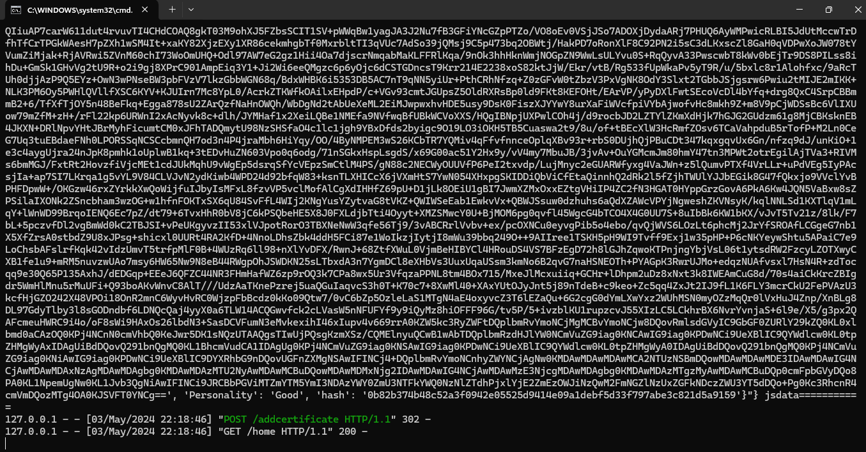
CERTIFICATE DATA IN BLOCKCHAIN

Slide 20
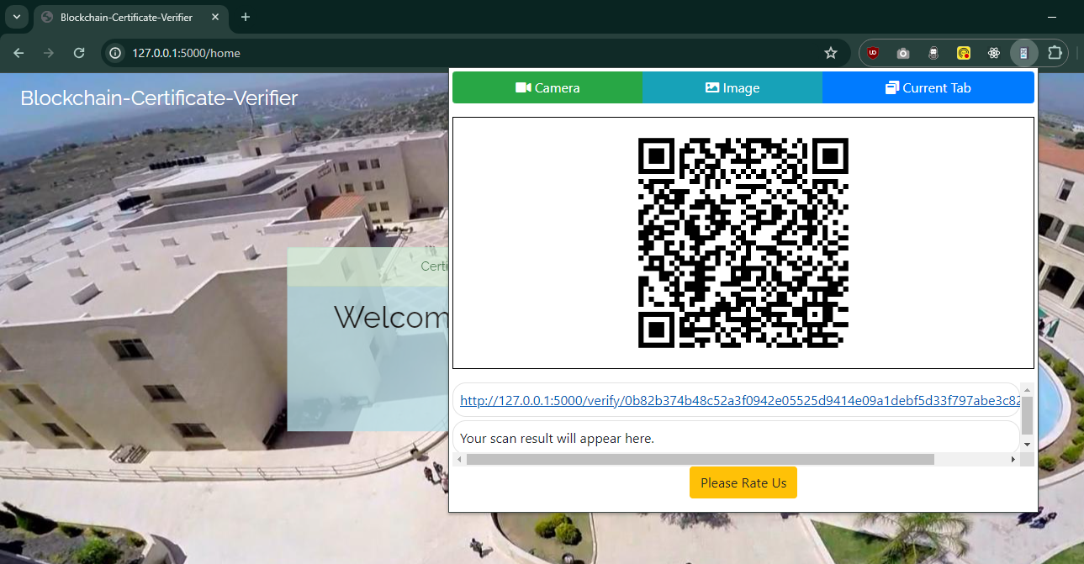
QRCODE READER FOR VERIFICATION

Slide 21
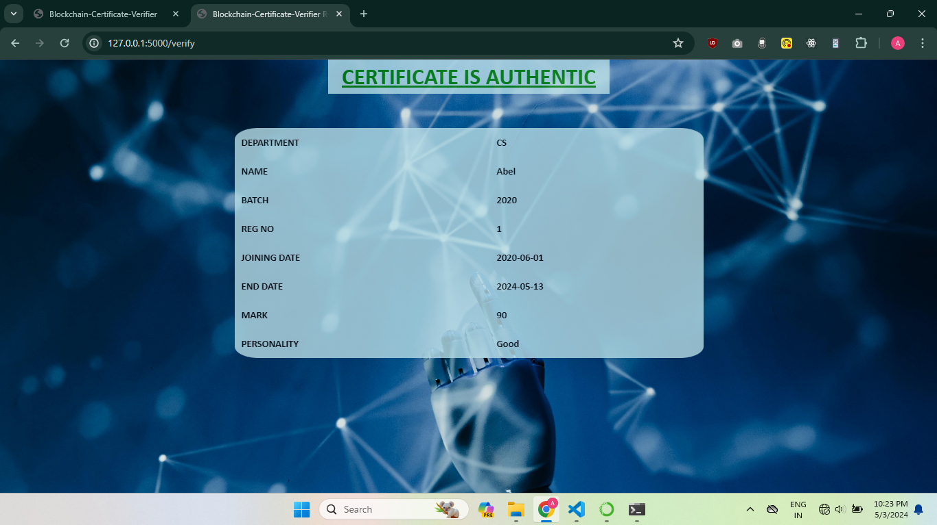
CERTIFICATE’S VERIFIED DATA

Slide 22
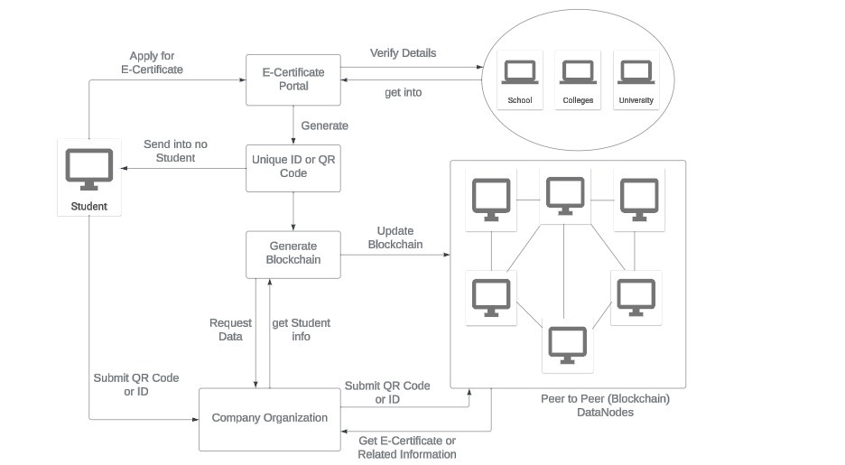
FLOWCHART

Slide 23
ALGORITHM
Hashing Algorithm:
SHA-256 algorithm is used for generating cryptographic hash of certificate data.
Ensures data integrity and tamper-proofing.
Validation Algorithm:
In Validation process, the certificate gets added to the blockchain and at the same time, a QRCode will be generated in the name of the user mentioned in the certificate.
This QRCode contains the certificate data along with authenticity via deployment in blockchain.
These QRCodes can be verified by scan the QRCode using a specific browser extension. This verification takes place locally within the blockchain network.

Slide 24
IMPLEMENTATION DETAILS
Wrote a code for backend which contains APIs for,
Login
2. Signup
3. Admin
4. User
5. Certificate template form
6. Certificate updation
7. Certificate creation
8. Certificate validation
9. Certificate verification

Slide 25
IMPLEMENTATION DETAILS
Backend Codes for 3 models, controllers which are as below,
Certificate
2. Template
3. User
Backend Codes for 4 routes which are as below,
Certificate
2. Template
3. User
4. Index

Slide 26
IMPLEMENTATION DETAILS
Wrote a code for frontend which contains the section as below,
Login
Signup
Dashboard
Certificate generation
Template form
Navigation bar
Add Certificate
Validate Certificate
Verify Certificate
If Validated, Authentic Certificate data
Else, Verification failed

Slide 27
CONCLUSION
To sum up, creating the Online Blockchain-based Certificate Generation and Validation System for Government Organizations is a big step forward in how certificates are handled. This system uses blockchain technology, which makes it strong and safe for issuing and checking certificates.

Slide 28
REFERENCES
https://aws.amazon.com/amplify/
https://devfolio.co/projects/digicerti-2b65/update/ce13024565ee40159850a4440212aa04
https://ijcrt.org/papers/IJCRT2107013.pdf

Slide 29
FUTURE IMPLEMENTATION
In our future endeavors, our primary focus will be on seamlessly integrating both the validation component leveraging blockchain technology and the development of a comprehensive Administrative Dashboard. This integration will not only enhance the efficiency and transparency of our certificate generation and validation system but also provide administrators with robust tools and functionalities to effectively manage and oversee the entire process. By prioritizing these aspects, we aim to further optimize our platform's capabilities, ensuring it remains at the forefront of technological advancements in the field of government organization certificate management systems.

Slide 30


